Slide 1
SARDAR PATEL INSTITUTE
of
TECHNOLOGY

Slide 2
Water Conservation:
The Facts and What you Can do About it.
BY:- 1st SEM AUTOMOBILE

Slide 3
Prepared by:-
Patel Jaimin [130680102026]
Jani Chirag [130680102012]
Patel Mit [130680102031]
Patel Rhutul [1306801035]
Joshi Arpana [130680102013]
Ghodasara Mayank[130680102009]
Guided by:- Khushbu A. Patel

Slide 4
What is water conservation?

Slide 5
GOALS
Understand the Need for Water Conservation.
Understand the Need for Monitoring, Submetering, and Leak Detection.
Be Familiar With How Water Pressure Relates to Water Conservation.
Understand the Principles of Water Recycling and Water Reuse.
Be Familiar With Cooling Water Conservation.
Be Familiar With Industrial Water Conservation Measures.
Understand Bathroom Water Conservation Measures.
Understand the Basic Principles of Xeriscape Landscaping.
Understand the Importance of Water Conservation Education and Employee Participation.

Slide 6
Why conserve water??

Slide 7
Continue…

Slide 8
Typical Household water use

Slide 9
Water Facts
Bathroom claims nearly 75% of water use
In 1990, the average person used 183 gallons of water per day.
The water use is about 50% higher in the west than the east.

Slide 10
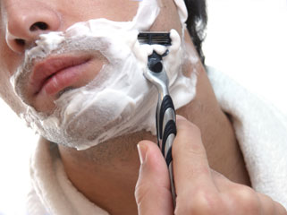
Shave and a haircut… …a bit more than “two bits”
Turn off the water while shaving. Fill the bottom of the sink with a few inches of water to rinse your razor.
Saves five gallons each day.

Slide 11
Ways to conserve water

Slide 12
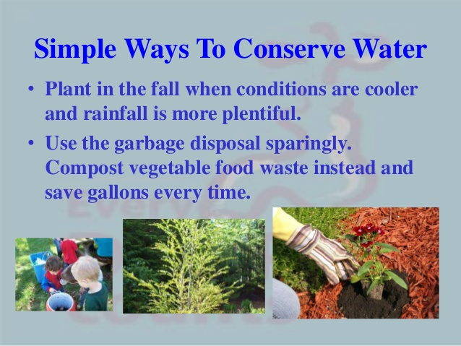
Ways to conserve water

Slide 13
Rainwater Harvesting for Consumption
Cost less than $1500 to build
Softer Water: 5mg/gal of dissolved minerals as compared to 500 in city water.
Cut water use by 95%
Many use similar system for laundry and toilets.

Slide 14
“Sawdust Toilet”
When used, add layer of sawdust to absorb odors.
When full, empty into compost pile
Some save urine separately. Can be diluted and used on plants for its nitrogen richness.

Slide 15
Tips from the Errsons
Dishwashing:
Wash all dishes at once
Then rinse all at once
Bathing:
Catch the water while the shower is warming up to water plants
Turn water off while you are soaping up
Laundry:
Use cold water
Buy front loader machine
Toilets:
Use water saver version
Better yet use compost toilet
Use Rain barrels for garden water

Slide 16
Another Somewhat Extreme Idea

Slide 17
Waste Water Wetlands
The system will function in the dormant as well as the summer season.
The oxidizing purification occurs in the root activity not the nutrient removal
1 sq. ft for each gallon of daily flow.
Needs:
A 2 cell septic tank (removes sludge)
Then a wetland constructed of 12-18 inches of gravel with native plants for the water to slowly pass through

Slide 18
H2O House

Slide 19
Bath

Slide 20
Toilet Talk

Slide 21
Toilet Tidbits
A family of 4 uses 881 gallons of water per week just to flush their toilet.
If everyone in the US flushed one less time a day, we could save enough water to make a square mile lake that is four feet deep everyday.

Slide 22
Toilet
Toilets made before 1993, use between 3.5 and 8 gallons per flush.
Newer toilets use less than 1.6 gpf.
This becomes a water use difference of 9.7 gallons per day
Improved toilets can save a family between 14-17 thousand gallons of water per year.
Some cities and utility companies offer incentives ranging from $25-100 or free toilet replacement.

Slide 23
The Toilet Comparison

Slide 24
Saving water
Add bricks or two liter bottles filled with water to your tank to reduce gpf.
Add food coloring to the tank, wait 30 mins. If the bowl is colored then you have a tank leak.
Running water while shaving or brushing teeth, wastes more water than what one person needs for an entire week.

Slide 25
Shower

Slide 26
Shower improvements
Take shorter showers
Replace shower head with water savers that use 2.5 gpm or less
Do not take baths. The typical bath uses over 50 gallons of water.
Consider collecting excess water for use on house plants.

Slide 27
Kitchen

Slide 28
Kitchen Facts
Typical dishwasher uses between 8 and 15 gallons per load. High efficiency washer use around 6.
The Dishwasher is about 1.4% of typical water use.
Faucets represent 15.7% of the typical water use.
One drip per second from a faucet will waste 2,700 gallons per year

Slide 29
Kitchen Improvements
Install low-flow faucet aerators.
Only run dishwasher when full.
New dishwashers are powerful. Don’t pre-wash dishes.
Collect excess sink water for watering plants

Slide 30
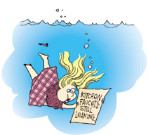
Kitchen (Continued)
A garbage disposal wastes lots of water.
Compost instead
This will also reduce solid waste in waterlines by 50% or more.
Do not leave running while washing dishes.

Slide 31
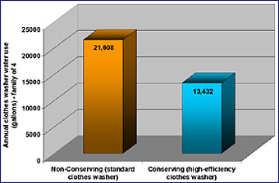
Laundry
Replace old washer with water saver model. New models use 23 gallons as compared to the 41 of older machines.
Only wash full loads.
Pretreat stains to avoid rewashing
The washing machine accounts for 21.7% of typical water use.

Slide 32
What is Grey Water and Dual Plumbing?
Grey water is domestic wastewater from sinks, tubs, and clothing washers that is used for lawn care
Dual plumbing is a process of recycling water by having to separate drainage lines to the city utility. St. Petersburg, Fl currently is using this process.

Slide 33
Grey water system or Dual Plumbing
Not legal in some cities and states. This stifles the ability to market and sell this technology.
Will keep your plants and lawn thriving in drought conditions.
Provides lots of organic materials for the plants as well.
Must monitor plants for over fertilization and watering.
Must be careful about ingredients in laundry soaps and cleaners, some can harm your plants.
A family of four can create 30-40 thousand gallons of water, if system is used to full potential.

Slide 34
The Car Wash
A 15 min. car wash uses 100 gallons of water.
Use a bucket of water and rags instead
Go to a commercial car wash that reuses their water.

Slide 35
The Family Pool
Ways to Save:
A pool cover
Repair any leaks
An inch a day leak in a 15 X 30ft pool wastes 102,000 gallons.
Turn heat down to slow evaporation.
Maintain pool to avoid water waste in refilling it.
Keep water in pool.

Slide 36
Xeriscape: History
The purpose of Xeriscape was to popularize landscape water conservation and to educate people about the importance of water to humans and other life forms.

Slide 37
Benefits of Xeriscape
Reduces water use
Reduces fertilizer use
Reduces pesticide use
Lower maintenance costs
Reduces runoff
Preserves Topsoil
Drought Tolerant
Lower maintenance needs

Slide 38
Using your water meter to conserve
Leaks can account for more than 10% of a typical families water bill.
On a straight reading meter, read it just like a car odometer.
A “round reading dial”:
Start with the 100,000 ft dial and work around to the 1 ft dial. If between numbers round down.

Slide 39
Examples of the dials

